Slide 1



Crypto 101
Oded Vanunu
Dikla Barda
Roman Zaikin
LIAD MIZRACHI

Slide 2


Smart Contract
A smart contract is a computer program or a transaction protocol which is intended to automatically execute, control or document legally relevant events and actions according to the terms of a contract or an agreement.
research.checkpoint.com
Notes:
https://www.blockchain.com/btc/unconfirmed-transactions

Slide 3
Remix a Smart Contract IDE
Remix is a powerful, open source tool that helps you write Solidity contracts straight from the browser. Written in JavaScript, Remix supports both usage in the browser and locally. Remix also supports testing, debugging and deploying of smart contracts and much more.
https://remix.ethereum.org/
research.checkpoint.com

Slide 4
Solidity
Solidity is an object-oriented programming language for implementing smart contracts on various blockchain platforms, most notably, Ethereum.
It was developed by Christian Reitwiessner, Alex Beregszaszi, and several former Ethereum core contributors. Programs in Solidity run on Ethereum Virtual Machine.
research.checkpoint.com

Slide 5
Solidity Contract
Simple contract looks like that
// SPDX-License-Identifier: MIT pragma solidity 0.8.10; contract dasp10 { string public name = "roman zaikin"; function updateName(string memory _newName) public { name = _newName; } }
License
Compiler Version
Contract Name
State Variable
Function
research.checkpoint.com

Slide 6
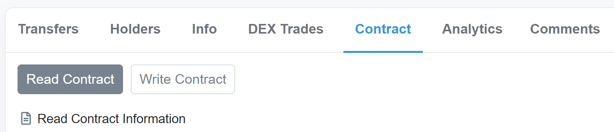
Solidity read vs write
As long as you are only reading data from the blockchain and not changing the blockchain, you don't need to carry out a transaction. The function you call is then carried out only by the node you are connected to and not mined, such that you don't need to pay any gas.
research.checkpoint.com

Slide 7
Solidity Visibility
Functions visibility:
Private – Private functions are like internal ones but they are not visible in derived contracts.
Internal – Internal functions can only be accessed from within the current contract or contracts deriving from it.
External – External functions are part of the contract interface, which means they can be called from other contracts and via transactions
Public – Public functions are part of the contract interface and can be either called internally or via message calls.
research.checkpoint.com

Slide 8
Solidity Global Variables
In solidity there are various global variables the most common are: block, msg, tx
contract dasp10 { uint256 public time = block.timestamp; address owner; address sender; function myFunction() public { owner = msg.sender; sender = tx.origin; } }
research.checkpoint.com

